Slide 1
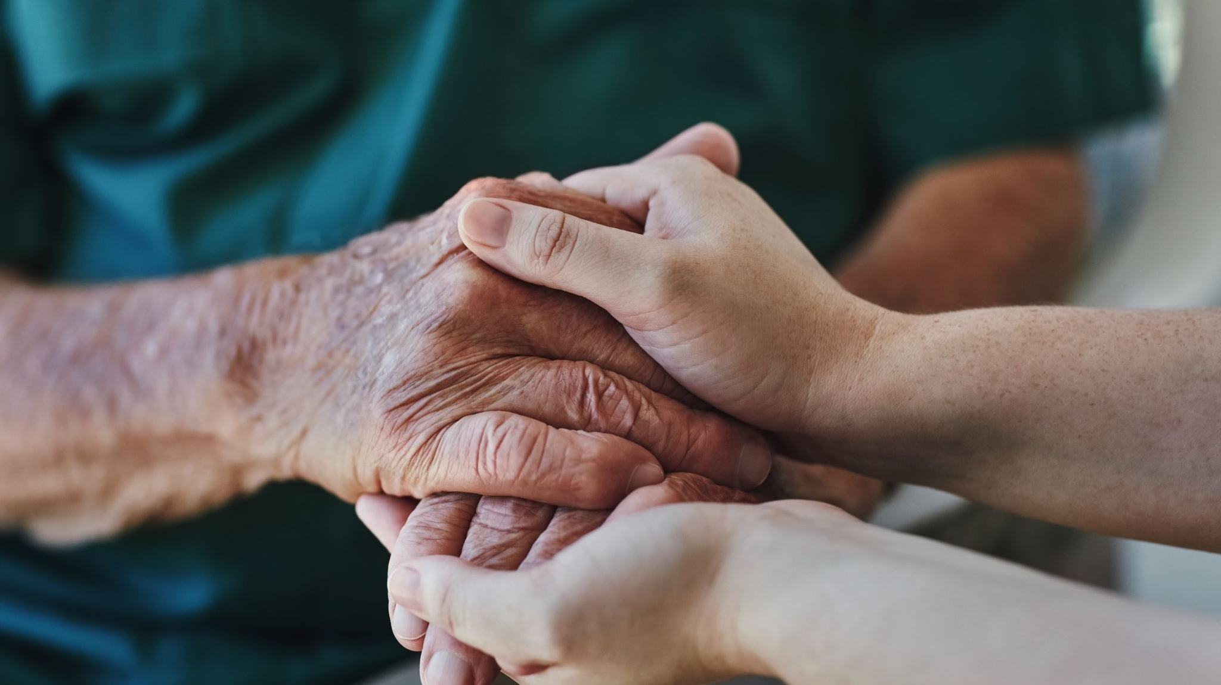
Displaced Victim Care

Slide 2



Plan of Action
Housing – Where can you put people, what kind of sleeping gear do you have, how many diplaced persons could you accommodate.
Food – What to feed large groups of people? 6-8 easy large group meals and equipment to feed that many.
Water – Extra water will be needed for drinking, cooking, cleaning both bodies and clothes.
Other ideas

Slide 3
Spiritual Preparations
Pay an Honest Tithe and Generous Fast Offering
Add Oil to Your Lamp
Live Worthy of the Holy Ghost
Malachi 3:10 Bring ye all the tithes into the storehouse, that there may be meat in mine house, and prove me now herewith, saith the Lord of hosts, if I will not open you the windows of heaven, and pour you out a blessing, that there shall not be room enough to receive it.
11 And I will rebuke the devourer for your sakes, and he shall not destroy the fruits of your ground; neither shall your vine cast her fruit before the time in the field, saith the Lord of hosts.
“In that moment every family home evening lesson, scripture study session, prayer of faith offered, blessing given, testimony shared, covenant made and kept, house of the Lord attended, and Sabbath day observed mattered—oh, how it mattered! It was too late to put oil in our lamps. We needed every single drop, and we needed it right now!” Abide the Day in Christ, Sister Amy A. Wright
Nephi said, “And I was led by the Spirit, not knowing beforehand the things which I should do.” I have been encouraged by knowing that Nephi was guided by the Spirit minute by minute through the night on the Lord’s errand. We need, and you will need, the constant companionship of the Holy Ghost.
I have learned to follow the counsel of President Nelson to review my life for opportunities to repent. He reminds us, “Daily repentance is the pathway to purity, and purity brings power.”
Our Constant Companion, President Henry B. Eyring

Slide 4

House of Order
Mosiah 4:27“And see that these things are done in wisdom and order, for it is not requisite that a man should run faster than he has strength. And again, it is expedient that he should be diligent, that thereby he might win the prize; therefore, all things must be done in order.”

Slide 5

Set Up Routine and Communicate Often
Shower Schedule
Laundry Schedule
Chore and Cooking Schedule
Shopping Schedule
Activity Schedule
Computer and TV usage and schedule (limit news and social media that can be distressing and overwhelming)
Car Usage
Other?

Slide 6

Help connect them with resources for them to be successful. You can be a great listening ear and a comfort but there are many trained professionals who can help. You don’t have to do it all alone.

Slide 7

Be Flexible
Let go of control and expectations

Slide 8


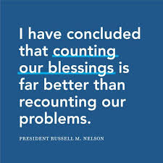

Give Thanks
Gratitude in All Things

Slide 9
Mental & Emotional Prepardenss
Play Calming Music
Invite and include guests in your family prayers and scripture study
Go for a walk or exercise
Utilize outdoor resources: Parks, Trails, Sport equipment, walk on the grass barefoot.
Take Time for Yourself: Read a book, draw, craft, play musical instrument, journal, family history work, nap
Meditation or breathing exercises
Call a friend, go on a soda run, talk with others experiencing the same type of things

Slide 10
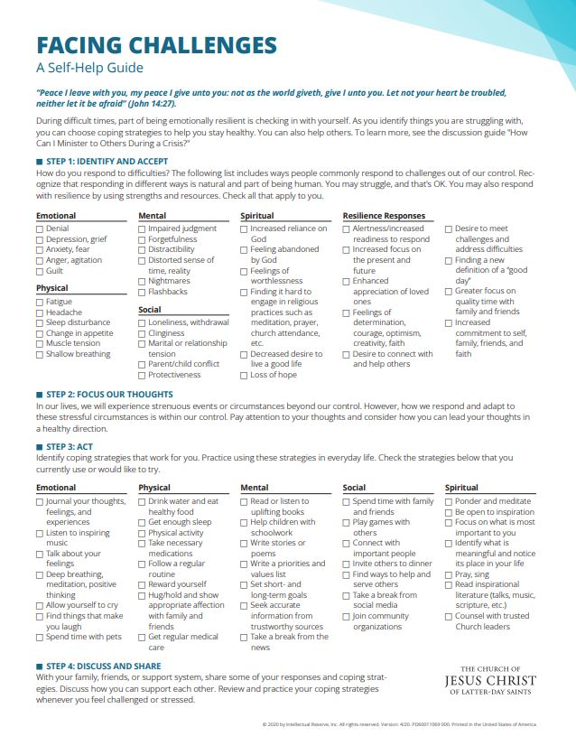
www.churchofjesuschrist.org Facing Challenges A Self-Help Guide Embrace the Future with Faith. Ensign Nov 2020

Slide 11

Mosiah 2:17 And behold, I tell you these things that ye may learn wisdom; that ye may learn that when ye are in the service of your fellow beings ye are only in the service of your God.
Matthew 25:40 And the King shall answer and say unto them, Verily I say unto you, Inasmuch as ye have done it unto one of the least of these my brethren, ye have done it unto me.
Christ has no hands but our hands to do His work today
He has no feet but our feet to lead men in the way
He has no tongue but our tongue to tell men how He died
He has no help but our help to bring them to His side.
—Annie Johnston Flint

